Slide 1
Introduction to business
Forms of Organization

Slide 2
Co-operative Societies
Co-operative Societies are group of people who form the business to co-operate with each other.
The main purpose of co-operative societies is to co-operate with each other through self help.
People join these organizations as volunteers.

Slide 3
Advantages
This system provides high standard of life due to sharing resources.
Formation is easy because Government support these kinds of organizations.
People running the business have equal rights in decision making regardless of number of shares or amount invested in the business.
Economic Democracy- people sit together and decide about the business of the society.
Elimination of middle man results in cheaper products.

Slide 4
Advantages
Government gives financial assistance to these types of businesses.
Friendly atmosphere is developed in the society due to close relationship in the people running the business.
Employment opportunities are created by such businesses.
A sense of mutual co-operation is developed in the society.
An opportunity to keep demand and supply in balance.
This kind of business requires less expenditures.

Slide 5
Dis-advantages
People do not have sufficient capital to start such business.
Unavailability to hire professional manager because:
People do not have money in remote areas.
There are not such experienced people in those areas.
People do not have experience of such business.
Lack of secrecy
These are not really businesses in true sense. People might not have confidence in these businesses.
Banks might not provide loans to these businesses.
Interference of government.

Slide 6
Mergers and acquisitions (M&A)
Mergers and acquisitions (M&A) is the area of corporate finances, management and strategy dealing with purchasing and/or joining with other companies.
In a merger, two organizations join forces to become a new business, usually with a new name. Because the companies involved are typically of similar size and stature, the term "merger of equals" is sometimes used.
In an acquisition, on the other hand, one business buys a second and generally smaller company which may be absorbed into the parent organization or run as a subsidiary. A company under consideration by another organization for a merger or acquisition is sometimes referred to as the target.

Slide 7
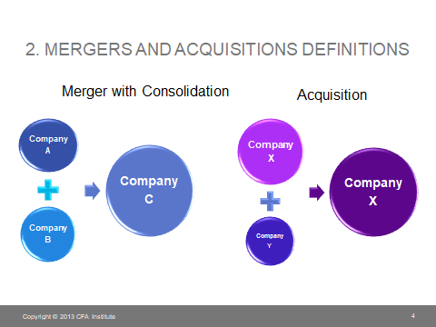
A merger is a legal consolidation of two entities into one entity, where as an acquisition occurs when an entity takes ownership of another entity’s stock, equity interest or assets.

Slide 8
Types of Mergers
Horizontal Merger
Vertical Merger
Froward and backward
Conglomerate
Concentric
Reverse merger

Slide 9
Horizontal Merger
When a company merges or takes over another company that offers the same or similar product lines and services to the final consumers, which means that it is in the same industry and at the same stage of production. Companies, in this case, are usually direct competitors.
For example, if a company producing cell phones merges with another company in the industry that produces cell phones, this would be termed as horizontal merger.
The benefit of this kind of merger is that it eliminates competition, which helps the company to increase its market share, revenues and profits. Moreover, it also offers economies of scale due to increase in size as average cost decline due to higher production volume.
These kinds of merger also encourage cost efficiency, since redundant and wasteful activities are removed from the operations i.e. various administrative departments or departments such as advertising, purchasing and marketing.

Slide 10
Vertical Merger
A vertical merger is done with an aim to combine two companies that are in the same value chain of producing the same good and service, but the only difference is the stage of production at which they are operating.
For example, if a clothing store takes over a textile factory, this would be termed as vertical merger, since the industry is same, i.e. clothing, but the stage of production is different: one firm is works in territory sector, while the other works in secondary sector.
These kinds of merger are usually undertaken to secure supply of essential goods, and avoid disruption in supply, since in the case of our example, the clothing store would be rest assured that clothes will be provided by the textile factory.
It is also done to restrict supply to competitors, hence a greater market share, revenues and profits.
Vertical mergers also offer cost saving and a higher margin of profit, since manufacturer’s share is eliminated.

Slide 11
Vertical Merger types
Forward Merger
Gaining ownership or increased control over distributors or retailers or customers.
Present distributors are especially expensive or unreliable
Availability of quality distributors is limited
Competes in an industry growing and expected to continue To grow
An organization has both capital and HR needed to manage for Distributing its own products
Present distributors or retailers have high profit margin

Slide 12
Backward Merger
Seeking ownership or increased control of a firm's suppliers
For example; Hotels Inc. Purchased a furniture producer
Boeing in march 2008 purchasing of supplier to its 787 airplane. it enabled them to overcome production problems that have delayed the delivery of the plane to British Airways and Virgin. they key benefit is security of supply.
Present suppliers are especially expensive or unreliable, have high profit margin.
Number of suppliers is small and the number of Competitors is large.
Competes in an industry growing and expected to continue to grow.
An organization has both capital and HR to manage new business of supplying its own raw materials
The advantages of a stable raw material price particularly important.

Slide 13
Concentric Mergers
Concentric mergers take place between firms that serve the same customers in a particular industry, but they don’t offer the same products and services. Their products may be complements, product which go together, but technically not the same products.
For example, if a company that produces DVDs mergers with a company that produces DVD players, this would be termed as concentric merger, since DVD players and DVDs are complements products, which are usually purchased together.
These are usually undertaken to facilitate consumers, since it would be easier to sell these products together. Also, this would help the company diversify, hence higher profits.
Selling one of the products will also encourage the sale of the other, hence more revenues for the company if it manages to increase the sale of one of its product. This would enable business to offer one-stop shopping, and therefore, convenience for consumers.
The two companies in this case are associated in some way or the other. Usually they have the production process, business markets or the basic technology in common. It also includes extension of certain product lines.
These kinds of mergers offer opportunities for businesses to venture into other areas of the industry reduce risk and provide access to resources and markets unavailable previously.

Slide 14
Conglomerate Merger
When two companies that operates in completely different industry, regardless of the stage of production, a merger between both companies is known as conglomerate merger. This is usually done to diversify into other industries, which helps reduce risks.

Slide 15
Reverse merger
A reverse takeover or reverse merger takeover (reverse IPO) is the acquisition of a public company by a private company so that the private company can bypass the lengthy and complex process of going public.
The transaction typically requires reorganization of capitalization of the acquiring company

Slide 16
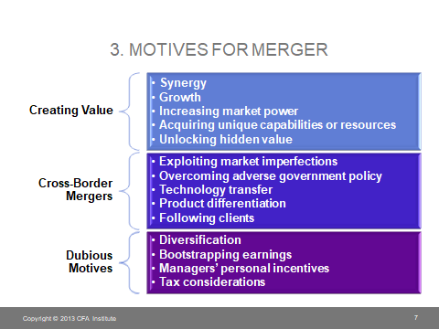
Motives for Merger

Slide 17
Acquisition
Acquisition on the other hand is a different process. It is a process in which one company overtakes the other (one or more) company.
It can be done with the mutual consent known as friendly acquisition. Or it can be done forcibly known as hostile acquisition.
This is generally done to come over the competitive threats.
Sometimes, the acquiring company comes to know about the process after acquisition, in case of hostile acquisition.

Slide 18
Types:
Acquisition Through Asset Purchase: In this type of acquisition, some specific assets of the target company are bought by the acquiring company. The acquiring company does this where the buying of assets help in its existing business also.
However, this process is not much supported as it is difficult to settle the issue, if any, on a later stage. And also target company has to pay tax on capital gains.
Acquisition Through Stock Purchase: Here the acquiring company buys all the equity of the target company. There is no change in the employees or the ongoing process. Just all the assets and liabilities are under the new owner. It is a very simplified and easy process.

Slide 19
Examples
Pakistan stock exchange (PSX)
The Pakistan stock exchange (PSX) limited came into existence in January 2016 when government of Pakistan decided to merge 3 big exchange markets (Karachi stock exchange, Lahore stock exchange and Islamabad stick exchange) of the country into one market. Launched on January 11, 2016 aimed to help reduce market fragmentation and create a strong case for attracting strategic partnerships necessary for providing technological expertise and assistance. PSXwas launched.

Slide 20
Merger of MyBank limited to Summit Bank
MyBank limited (now merge with summit bank on july 2011) was a bank located in karachi untill its merger with summit bank in july 2011. MyBank was incorporated in 1992 as a commercial bank in pakistan. Before acquistion it had 80 branches with PKR 5.303 billion paid up capital.

Slide 21
Examples
Polka
In 1994 Lever Brothers Pakistan tried to acquire Polka Ice Cream for Rs 600 million. Polka refused the bid, and demanded Rs 1 billion. One year after the launch of Wall's Ice Cream by Lever Brothers in 1995, Polka approached Wall's with an offer to merge the two companies.
Knorr
It was a German brand which Unilever acquired in year 2000.
Glaxose-D
Glaxose-D is a fifty year old brand which was acquired by Unilever Foods Pakistan Ltd. from Glaxo Wellcome Pakistan Ltd in January 1999.

